Slide 1
Serial communication

Slide 2
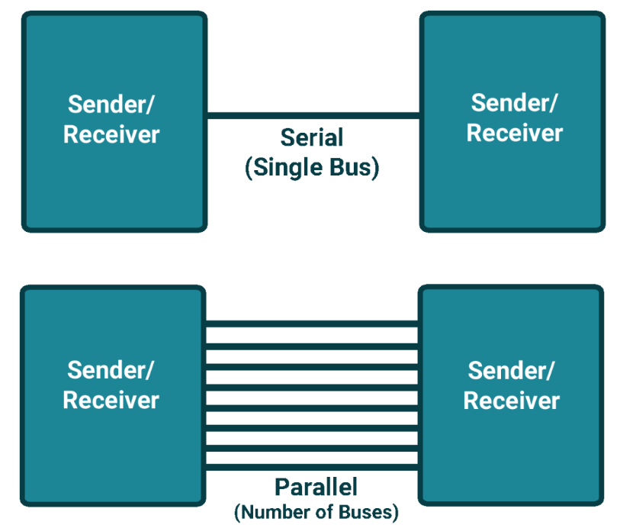

Slide 3
Serial communication
Serial communication means to transfer data bit by bit serially at a time, whereas in parallel communication, the number of bits that can be transferred at a time depends upon the number of data lines available for communication.
Two methods of serial communication are
Synchronous Communication: Transfer of bulk data in the framed structure at a time
Asynchronous Communication: Transfer of a byte data in the framed structure at a time
8051 has built-in UART with RXD (serial data receive pin) and TXD (serial data transmit pin) on PORT3.0 and PORT3.1 respectively.

Slide 4
Asynchronous communication
Asynchronous serial communication is widely used for byte-oriented transmission.
Frame structure in Asynchronous communication:
START bit: It is a bit with which serial communication starts and it is always low.
Data bits packet: Data bits can be 5 to 9 bits packet. Normally we use 8 data bit packet, which is always sent after the START bit.
STOP bit: This is one or two bits. It is sent after the data bits packet to indicate the end of the frame. The stop bit is always logic high.
In an asynchronous serial communication frame, the first START bit followed by the data byte and at last STOP bit forms a 10-bit frame. Sometimes the last bit is also used as a parity bit

Slide 5
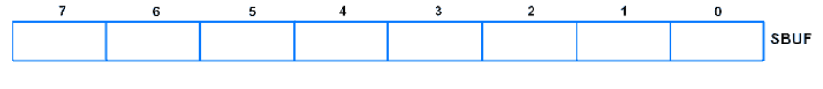

8051 Serial communication Registers
SBUF: Serial Buffer Register
This is the serial communication data register used to transmit or receive data through it.
SCON: Serial Control Register
Serial control register SCON is used to set serial communication operation modes. Also it is used to control transmit and receive operations.

Slide 6
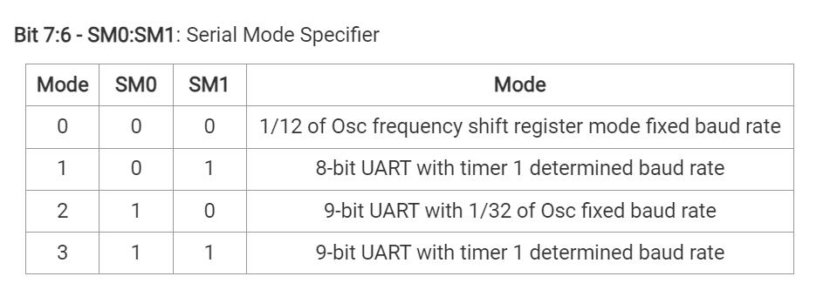
SCON

Slide 7
Bit 5 - SM2: for Multiprocessor Communication
This bit enables a multiprocessor communication feature in mode 2 & 3.
Bit 4 - REN: Receive Enable
1 = Receive enable
0 = Receive disable
Bit 3 - TB8: 9th Transmit Bit
This is the 9th bit which is to be transmitted in mode 2 & 3 (9-bit mode)
Bit 2 - RB8: 9th Receive Bit
This is the 9th received bit in mode 2 & 3 (9-bit mode), whereas in mode 1 if SM2 = 0 then RB8 hold the stop bit that received
Bit 1 - TI: Transmit Interrupt Flag
This bit indicates the transmission is complete and gets set after transmitting the byte from the buffer. Normally TI (Transmit Interrupt Flag) is set by hardware at the end of the 8th bit in mode 0 and at the beginning of stop bit in other modes.
Bit 0 – RI: Receive Interrupt Flag
This bit indicates reception is complete and gets set after receiving the complete byte in the buffer. Normally RI (Receive Interrupt Flag) is set by hardware in receiving mode at the end of the 8th bit in mode 0 and at the stop bit receive time in other modes.

Slide 8
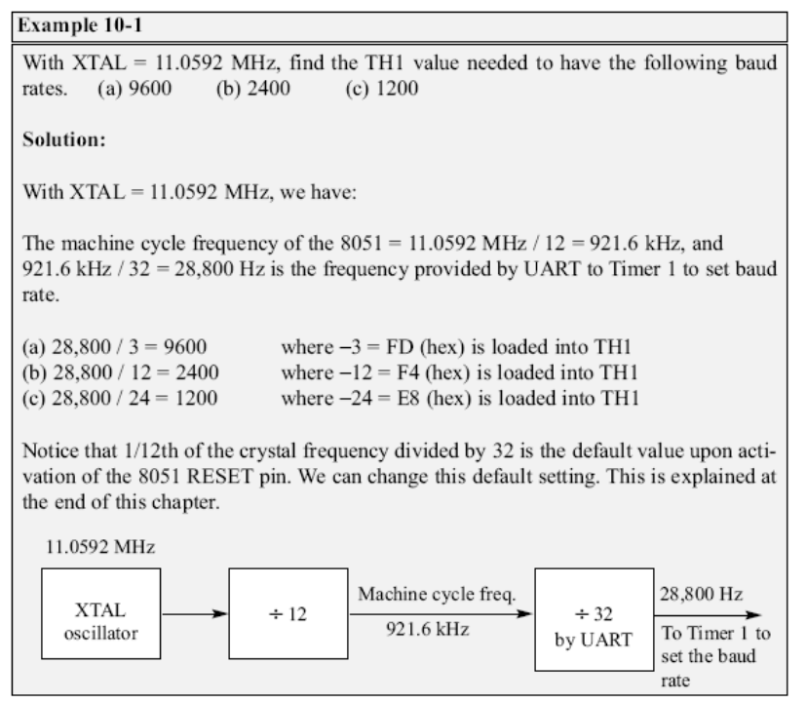

Slide 9
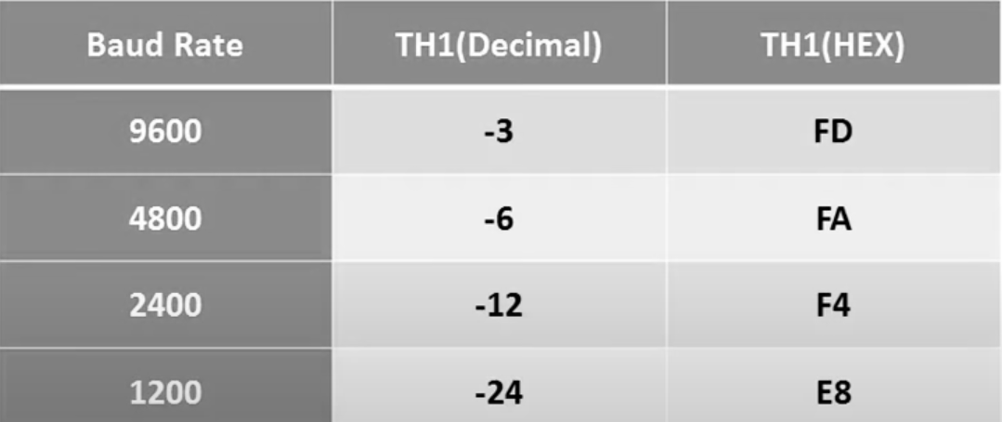

Slide 10
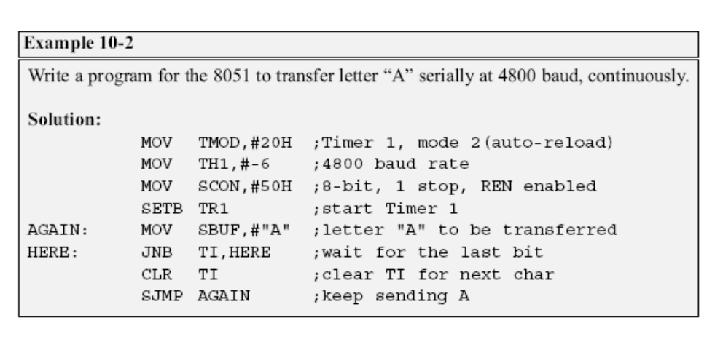
SERIAL TRANSMISSION

Slide 11
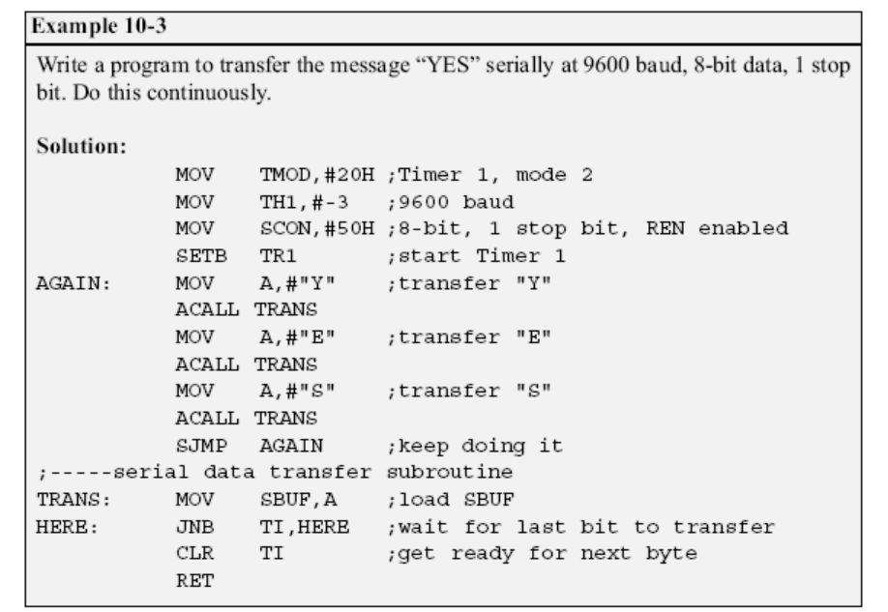

Slide 12
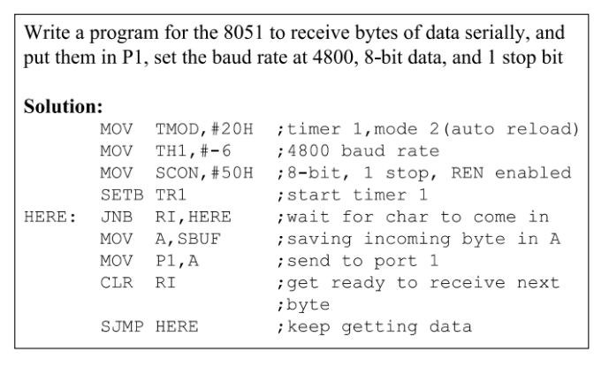
Serial Reception

